Slide 1
ECE 337 Design Review
Image Enhancement Package
Team Members: Chichen Fu
Chang Liu
He Li
Yang Wang
Teaching Assistant: Chuan Tan

Slide 2
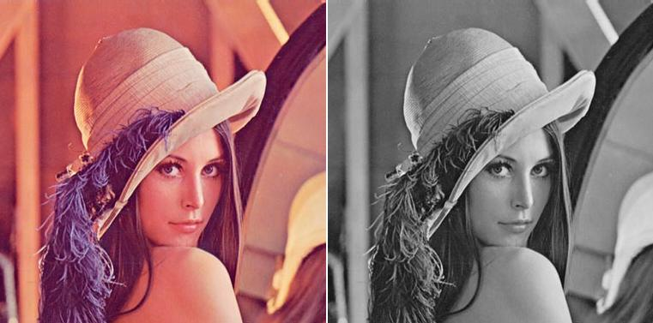


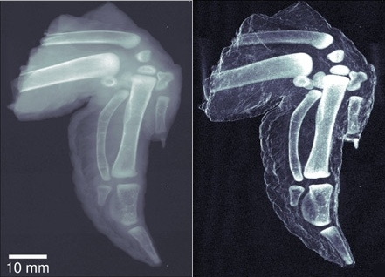
Purpose
Why do we need image enhancement (i.e., image processing)?
In daily life, we need to capture image for various purposes. However, the captured images are mostly not ideal for the viewers. We need to process the image for the desired results.

Slide 3
Our Design
Our chip design, the Image Enhancement Package, has four basic features that are quite useful for image processing purposes:
Brightness (+/-)
Contrast(+/-)
Grayscale
Black and white
The chip is small sized; so it’s suitable for surveillance cameras, medical cameras for capturing and processing images.

Slide 4
System Level Diagram
DE2i-150
Off-chip SRAM
Bridge
Off-chip SRAM
Image Enhancement Package
PCI-E
Avalon
Avalon

Slide 5
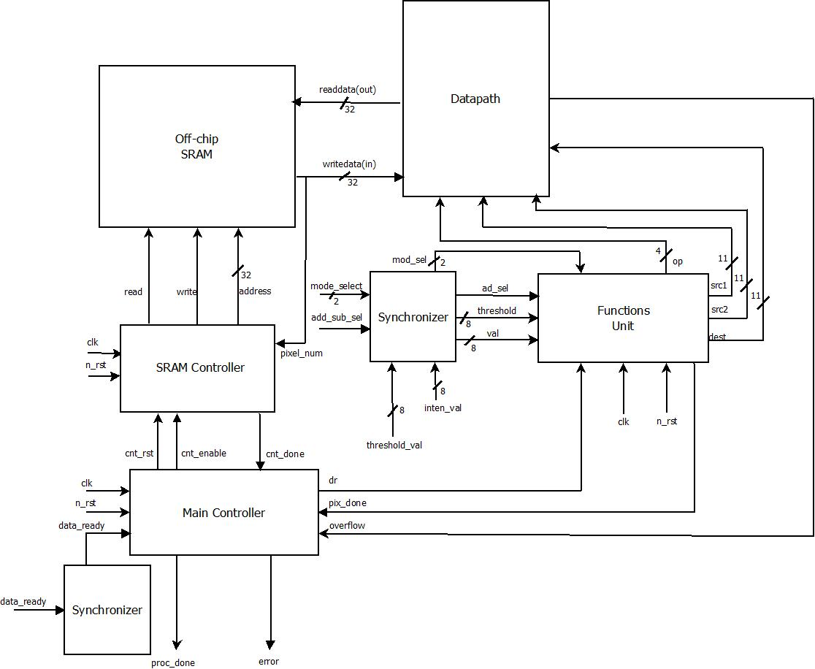
Architecture Diagram

Slide 6
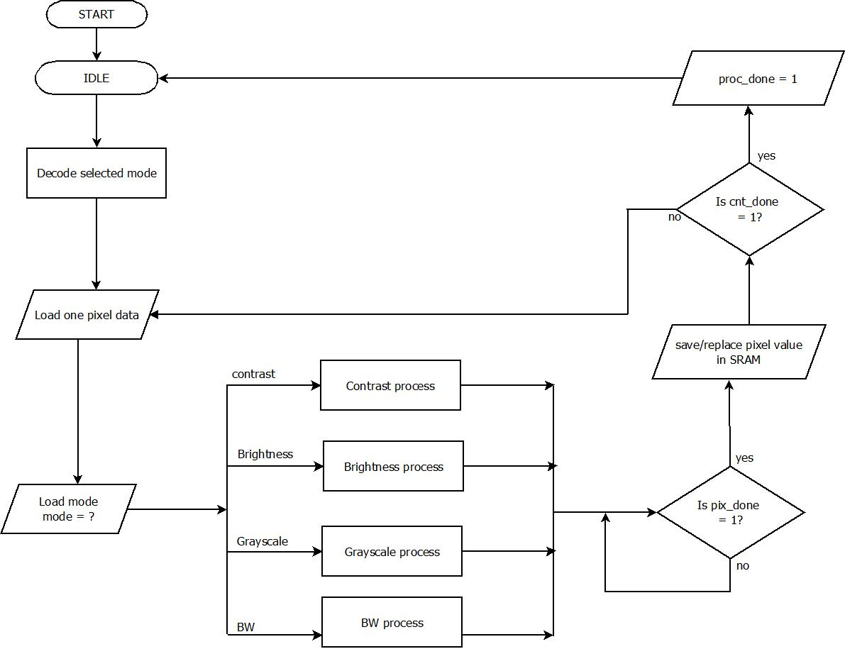
Sequence of operation

Slide 7
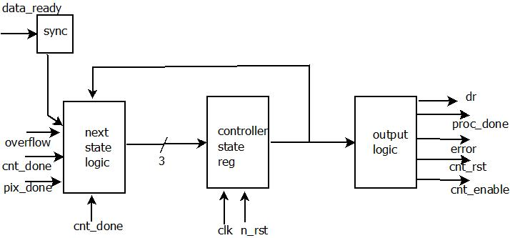
Main Controller

Slide 8
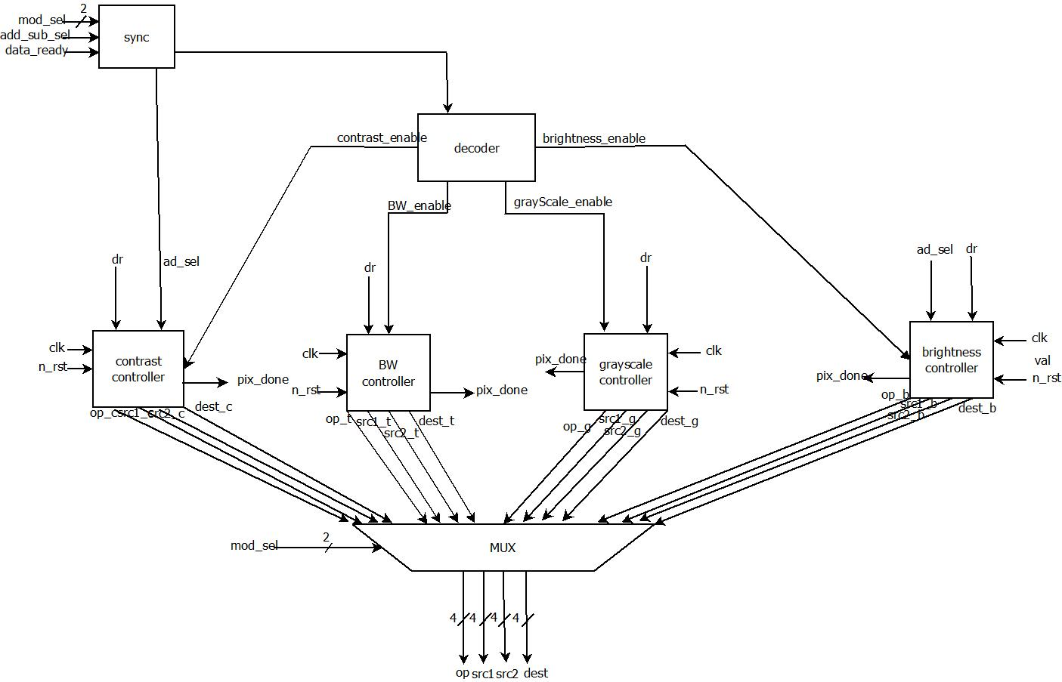
Functions Unit Block

Slide 9
Functions Unit Controllers

Slide 10
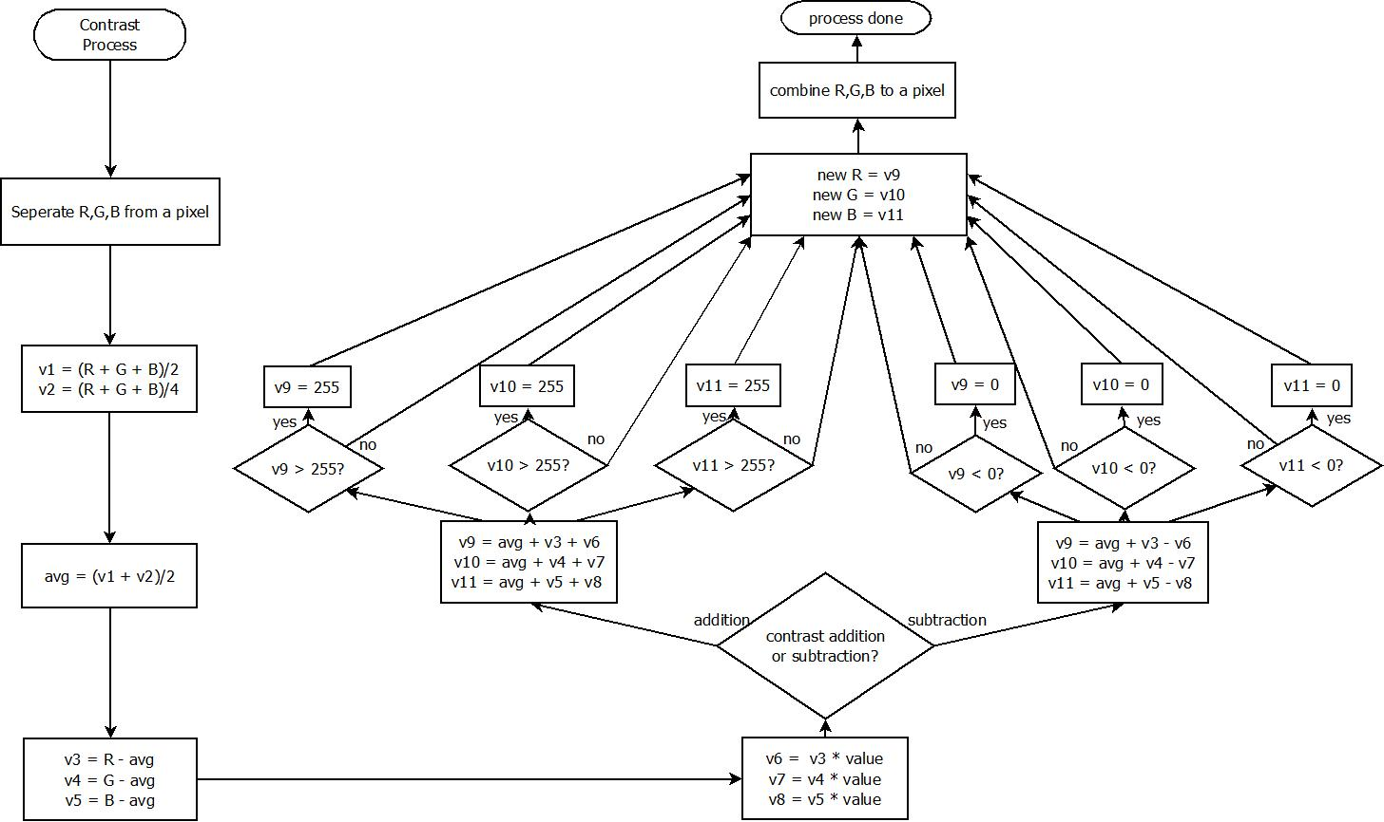
Contrast Controller

Slide 11
Brightness Controller

Slide 12
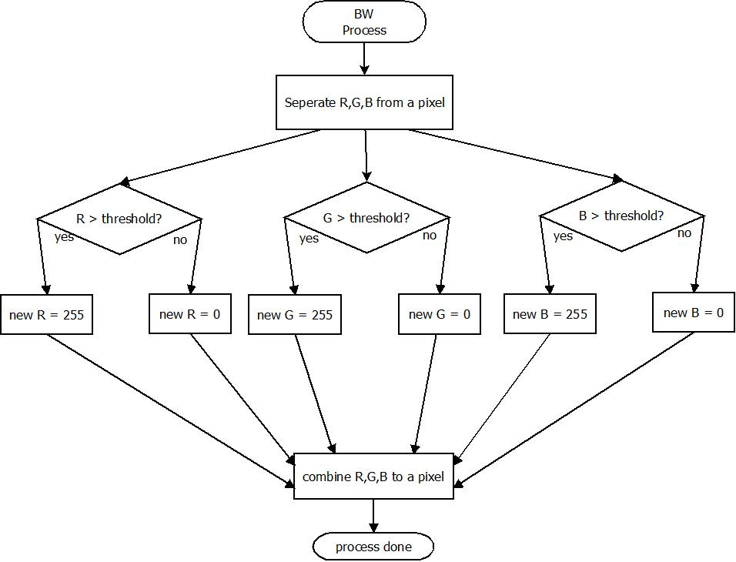
B&W Controller

Slide 13
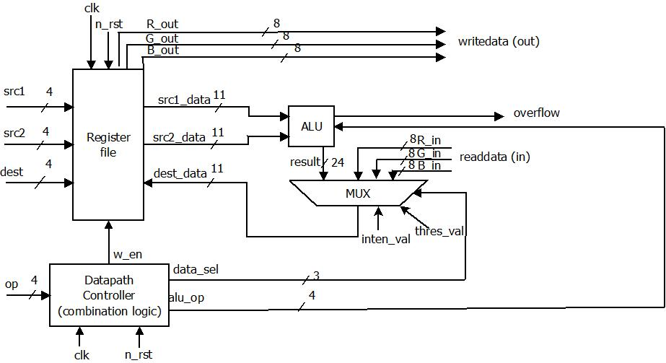
Datapath Block

Slide 14
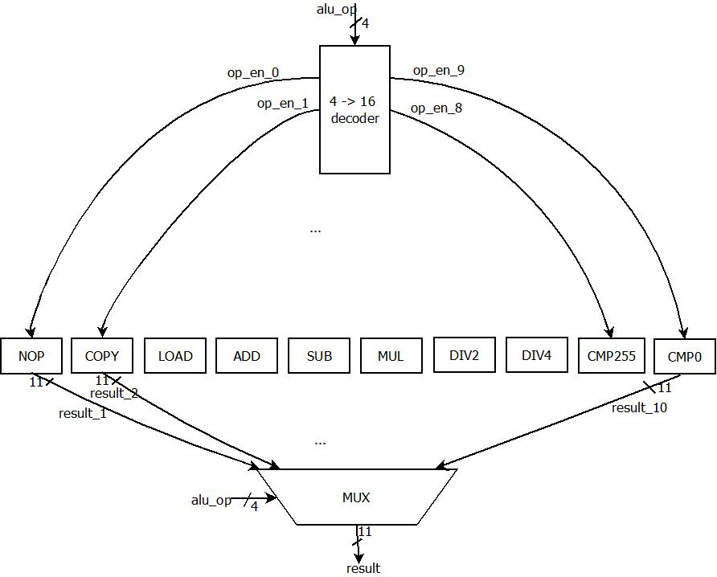
ALU

Slide 15
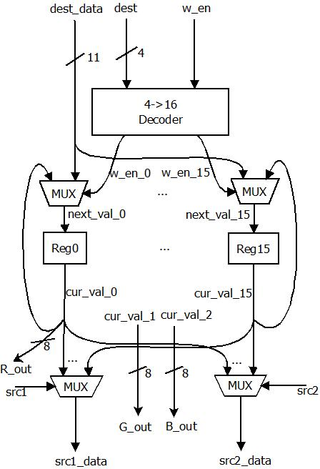
Register File
Reference: ECE 337 Lab 4: Introduction to FSM Controllers in Verilog

Slide 16
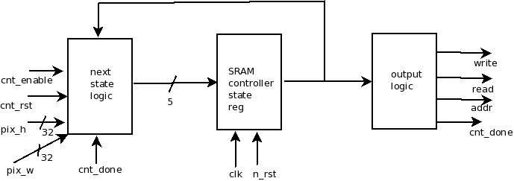
SRAM Controller

Slide 17
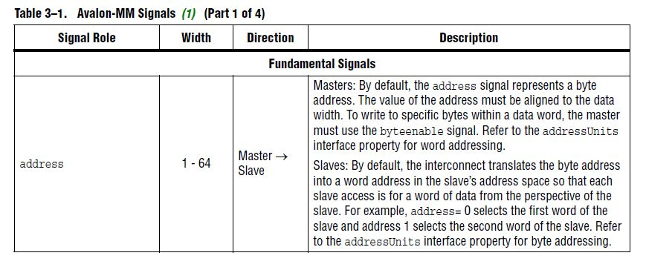
Avalon Bus Interface
Reference: Avalon Interface Specifications (Altera), May 2013

Slide 18
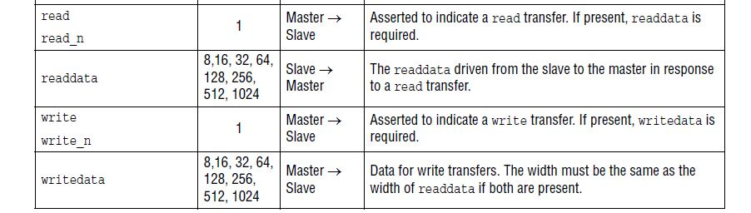
Avalon Bus Interface
Reference: Avalon Interface Specifications (Altera), May 2013

Slide 19
Area and Timing Budget

Slide 20
Area and Timing Budget

